Slide 1
Observer Pattern

Slide 2
Structure of Observer Pattern
Subject
<<Interface>>
attach(observer)
detach(observer)
notify()
Observer
<<Interface>>
update()
observers
*
subject
ConcreteObserver
update()
observerState
ConcreteSubject
getState()
setState(newState)
subjectState
Subject represents the actual state,
  The Observers represent different views of the state.

Slide 3
Inbuilt Java Observers
Support for Observer pattern is built into Java.
interface Observer {
void update(Observable o, Object arg);
} //java.util.Observer
class Observable {
void addObserver(Observer o) { … }
void deleteObserver(Observer o) { … }
void notifyObservers(Object arg) { … }
} //java.util.Observable base-class

Slide 4
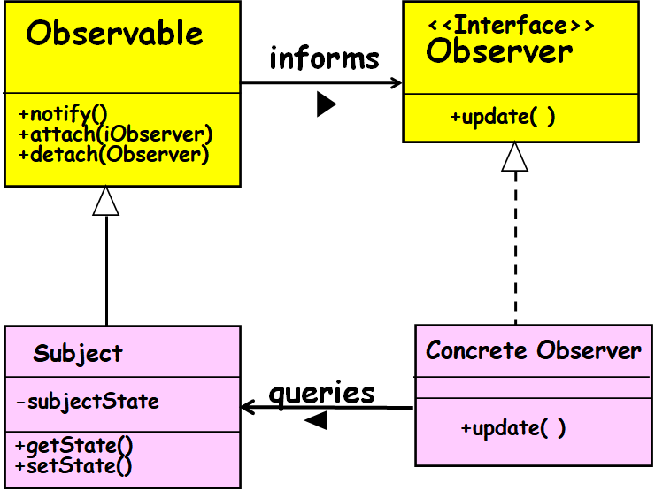
Java Observer/Observable
Observers register with Observable
Observable recognizes events and calls specified method of observers
Java Observer
  Interface class, implemented by observers
Java Observable
  Concrete Class

Slide 5
Java Observer Class
Must implement an update() method which the Observable object x will call:
  update(Observable x, Object y)
When Observable object x calls the update() method for a registered observer:
  It passes itself as a parameter and also a data object y…

Slide 6

Java Observable Class
Needs to be extended
Inherited methods from Observable
  addObserver(Observer z)
    Adds the object z to the observable’s list of observers
  notifyObserver(Object y)
    Calls the update() method for each of the observers in its list of observers, passing y as the data object

Slide 7
Java Support for Observer Pattern
interface Observer {
  void update (Observable sub, Object arg)
}
Subject.
class Observable {
…
}
  public void addObserver(Observer o) {}
  public void deleteObserver (Observer o) {}
  public void notifyObservers(Object arg) {}
public boolean hasChanged() {}

Slide 8
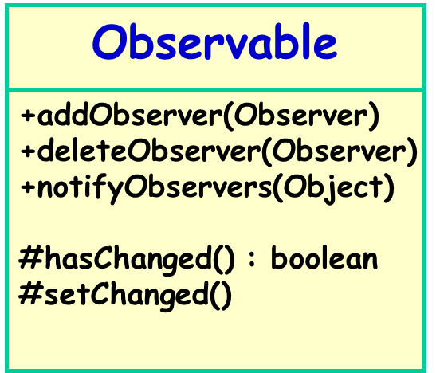
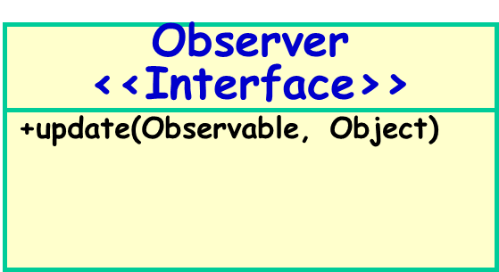
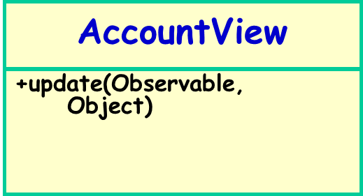
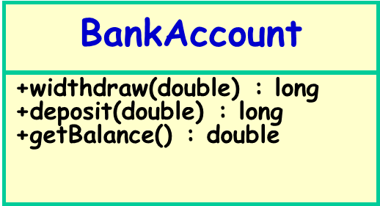
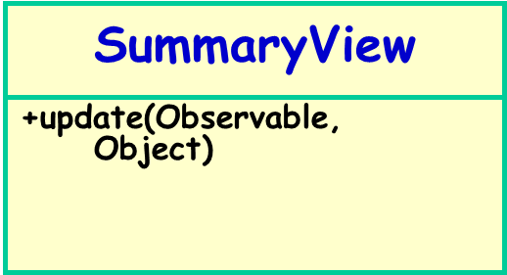
Poor Example of Observer Pattern Use

Slide 9
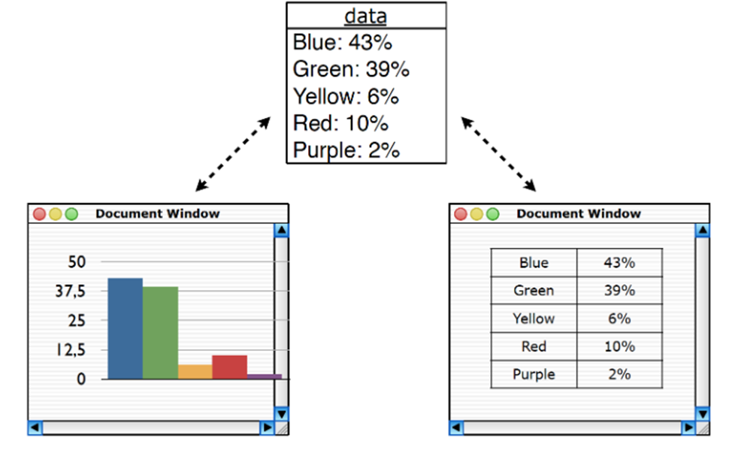
Observer Pattern- Implementation Example
public PiChartView implements Observer {
  void update(Observable sub, Object arg) {
  // repaint the pi-chart
  }
}
A Concrete Observer.
class StatsTable extends Subject{
public boolean hasChanged() {
// override to decide when it is considered changed
}
}

Slide 10
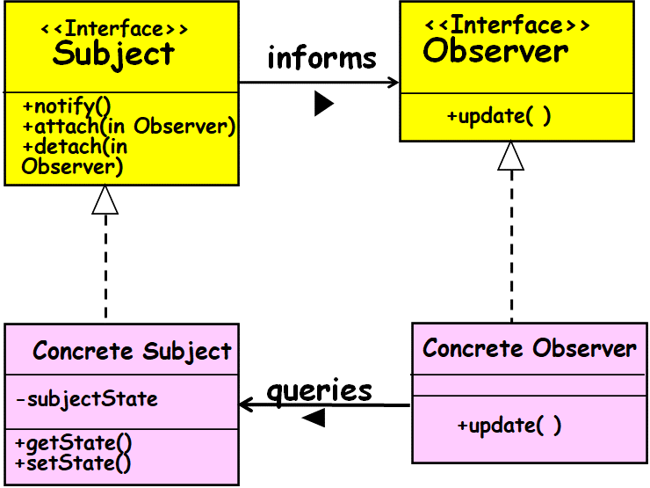
Observer Pattern - Consequences
Effectively removes coupling between subject and observer:
  subject need not know concrete observers
Support for broadcast communication:
  All observers are notified
Supports asynchronous updates:
  Observers need not know when updates occur

Slide 11
Consequences
  Modularity: subject and observers may vary independently
  Extensibility: can define and add any number of observers
  Customizability: different observers provide different views of subject
Implementation Issues
  Subject-observer mapping
  Dangling references

Slide 12
Some Limitations of Observer Pattern
Model objects incur substantial overhead:
  To handle registration of the observers,
  To respond to queries from observers.
Performance concerns:
  Especially when the number of observers is large…

Slide 13
Observer Pattern
Indications:
  Asynchronous update of model elements
  Observer and model states need to be consistent all the time
  Number of observers can change dynamically

Slide 14
Observer
Contra-Indications:
  Static data
  Fixed viewers

Slide 15
Java Observer Deprecated! Why?
It does not provide a rich enough event model for applications!
  For example, supports only the notion that something has changed, but does not convey any information about what has changed
Not threadsafe!
Programmers often make use of PropertyChangeListener instead:
  Which itself is an implementation of Observer pattern…

Slide 16

public class PCLBlog {
private String blogPostTitle;
private PropertyChangeSupport support;
public PCLBlog() {
support = new PropertyChangeSupport(this);
}
public void addPropertyChangeListener(PropertyChangeListener pcl) {
support.addPropertyChangeListener(pcl);
}
public void removePropertyChangeListener(PropertyChangeListener pcl) {
support.removePropertyChangeListener(pcl);
}
public void setBlogPostTitle(String value) {
support.firePropertyChange("blogPostTitle", this.blogPostTitle, value);
this.blogPostTitle = value;
}
}

Slide 17
Home Work
Provide class design for:
Blog application: Any one can enrol by providing e-mail. Any blog posted is communicated to the registered users.
Cricket application: Any one can enrol by providing e-mail. Any development (runs, out, over etc) posted is communicated to the registered users.

Slide 18

public class Blog extends Observable {
private List<Observer> subscribers = new ArrayList<>();
public void addBlogPost(String blogPostTitle) {
notifyObservers(blogPostTitle);
}
public void notifyObservers(String blogPostTitle) {
for (Observer subscriber : subscribers) {
subscriber.update(this, blogPostTitle);
}
}
public void registerObserver(Observer newSubscriber) {
this.subscribers.add(newSubscriber);
}
public void removeObserver(Observer previousSubscriber) {
this.subscribers.remove(previousSubscriber);
}
}

Slide 19
MVC: History
As compared to the Observer pattern:
  More appropriate in certain situations.
First developed by Xerox PARC for Smalltalk-80.
Used by the Application Kit system in NeXTstep.
  Used by the Cocoa APIs for Apple’s OS X.
It is the recommended structural framework for developing J2EE applications.

Slide 20
Subsequently…
A heavily used architectural design pattern…
The main theme of:
  Struts
  Ruby on Rails
  Java Server Faces (JSF)

Slide 21

Model-View-Controller (MVC) Pattern
Breaks an application into three parts:
  Model maintains data (State),
  View displays the data.
  Controller handles user events that may affect the model or views.
sees
Uses
View
Changes
Controller
Updates
Manipulates
Model

Slide 22
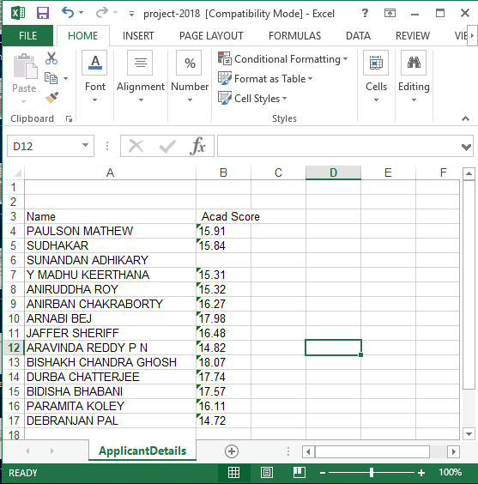

Slide 23
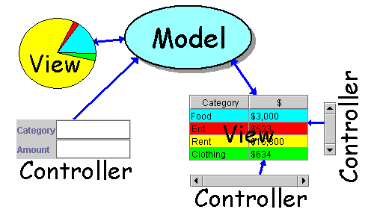
MVC Architecture
A typical application includes:
  Model: Maintain application data,
    Data in a spreadsheet, or
    state of a chess game -- positions of pieces
  View: Present output
    Data in table or pie chart or bar chart
    Graphical view of chess game
  Control: Handle user input
    key presses
    mouse click on controls

Slide 24
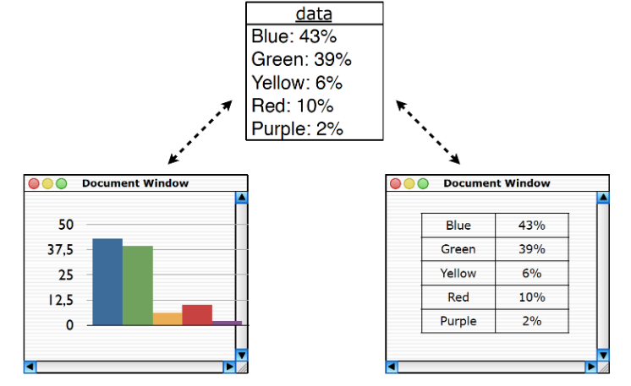
Dependency Among MVC Elements

Slide 25
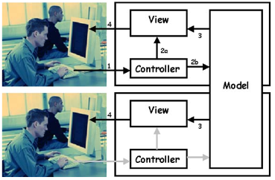
Multiple Views and Controls

Slide 26
MVC incorporates Observer Pattern!
Observer
+ update()
Model
-CoreData
-SetOfObservers
View
attach
-myModel
-myController
+attach(Observer)
+detach(Observer)
+notify()
+getData()
getdata
+initialize (Model)
+makeController()
+activate()
+display()
+update()
Controller
display
-myModel
-myView
detach
+initialize (Model, View)
+handleEvent()
+update()
attach

Slide 27
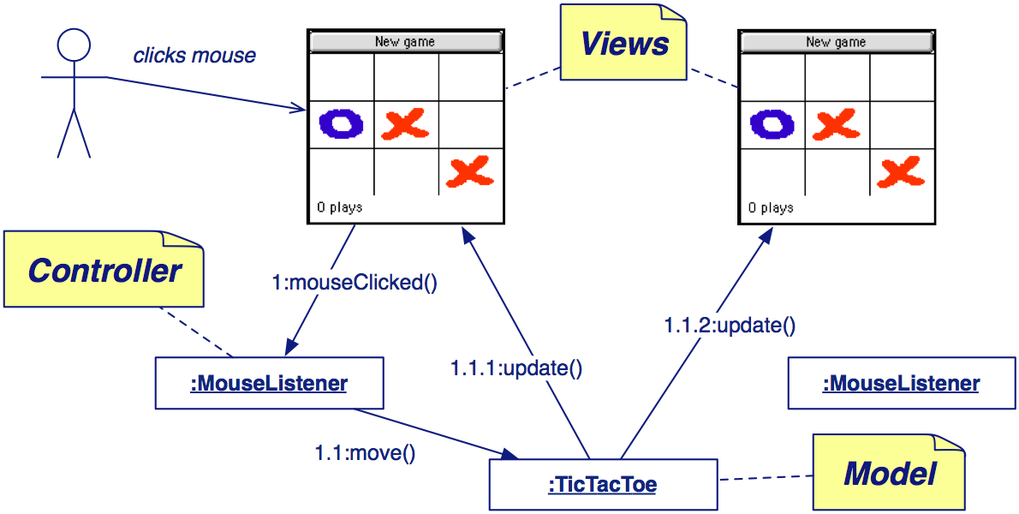
Model-View-Controller: Example

Slide 28
MVC in Web Application Development
Model: handles business logic
  Data retrieval & manipulation
  Including checking “Business Rules”
View: user interface (UI) component
  Front-end generation: html in browser
  The LOOK of the application
Control: deals with UI events
  Triggered by user using the UI
  The FEEL of the application

Slide 29
MVC: Another Example
View
Controller
Model
catalog
Customer
addItem
show
catalog
dbms
Shopping
cart
removeItem
checkout
Show
shoppingCart
Show
confirmation

Slide 30
aConcrete
Subject:
aConcrete
Controller:
aConcrete
Observer:
setState( )
notify( )
update( )
getState( )
update( )
getState( )

Slide 31
MVC Example: Word Processor
Control
Model
View
insertText
notify
getText
repaint

Slide 32
MVC Pattern in Java Swing
Swing uses the model-view-controller architecture (MVC) as the fundamental design behind each of its components. Essentially, MVC breaks GUI components into three elements. Each of these elements plays a crucial role in how the component behaves. The model encompasses the state data for each component. Robert Eckstein

Slide 33
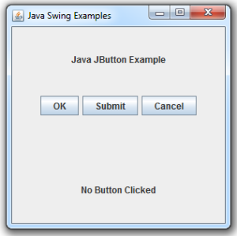
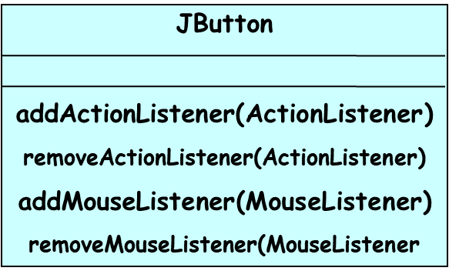
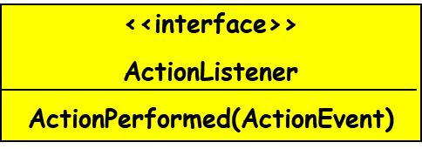
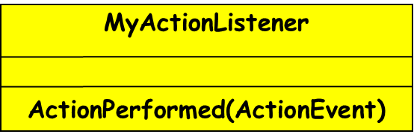
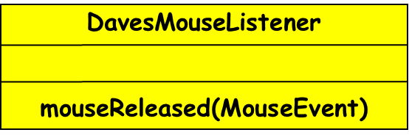
JButton Example
<<interface>>
EventListener
<<interface>>
EventListener
* 1
1 *
<<interface>>
MouseListener
mouseReleased(MouseEvent)

Slide 34
MVC: Benefits in a Nutshell
Benefits:
  Separation of concerns
  Easier to understand and maintain

Slide 35
Advantages of MVC (1)
Sapana Mehta (CS-6V81)
View
Controller
Separates Model from View:
  Implies separating internal data representation from presentation
Changes to views and controllers are localized:
  Model and View components can vary independently enhancing maintainability, extensibility, and testability.
Model

Slide 36
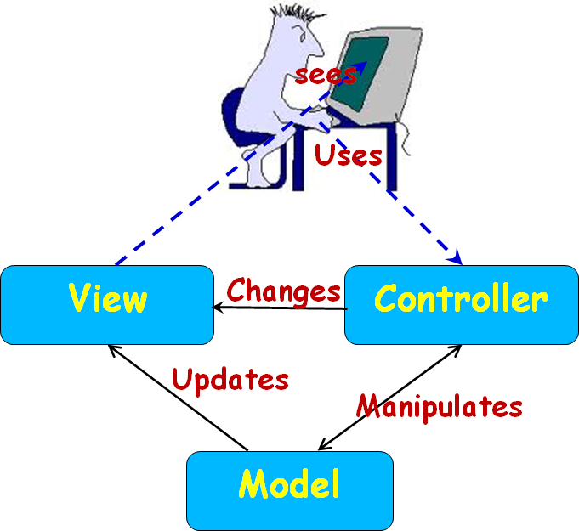
Advantages (2)
New views and controllers can be added to the model when required.
Easy to add:
  Multiple views
  New types of views of model data as per requirement.
CS 3331

Slide 37
Advantages (3)
Sapana Mehta (CS-6V81)
Separates Controller from View:
  Permits run-time selection of an appropriate View based on user preference, or model state.
Separates Controller from Model:
  Allows configurable mapping of user actions on the Controller to modify the Model.

Slide 38
What is Struts?
Struts is a framework to develop web application easily.
  As well as to maintain them.
Struts is an open source framework:
  Based on Java Servlets and JSP technologies.
Struts framework was created by Craig R. McClanahan :
  Donated to the Apache software foundation in 2000.

Slide 39
Struts Framework
Based on MVC architecture to develop J2EE web application:
  “Write once, Run Anywhere”
  Supports different model implementation (Javabeans, EJB, etc.)
Extends the Java Servlet API.
  Supports different presentation implementation (JSP, XML/XSLT, JSF).
Digression

Slide 40
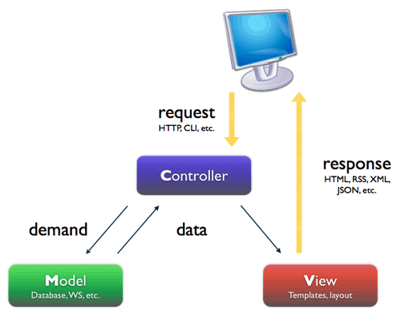
JSP+Servlets+JavaBeans :Web Application Architecture
Servlet
JSP File
Java
Digression
Server

Slide 41
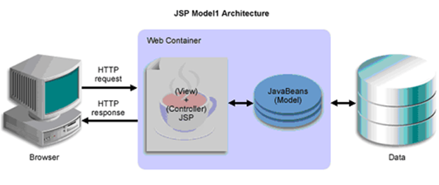
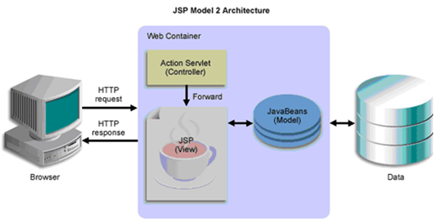
Web Application Models
Digression

Slide 42
What is a Web framework?
Web framework is a basic readymade underlying structure, where you have to just add components related to your business.
  For example, struts comes with all jars you might need to develop basic request response cycle. It provides the controller servlet or filter which will read your request and convert it to integer or float etc according to your business requirements. If there is any exception while converting, you don’t have to deal with that. Framework deals with the problem and displays you exact message.
  After all conversion, the framework automatically populate all your data needed from form to the java object.
  You don’t have to write much code to validate all your form data. Frame work provides some basic automatic validations.
  After you write business logic, you don’t have to write code to dispatch request to another page. Etc
It forces the team to implement their code in a standard way. (helps debugging, fewer bugs etc).
  For Example, in struts immediate backend logic should be in action classes’s method. Action class functions intern can call other components to finish business logic.
Framework might also help you develop complex User Interface easily like iterating tables, the menu etc (provide some tag libraries )
Using frameworks like struts 2.0, one need not have to have deep knowledge of Http protocol and its request and responses interfaces to write business logic.
Digression

Slide 43
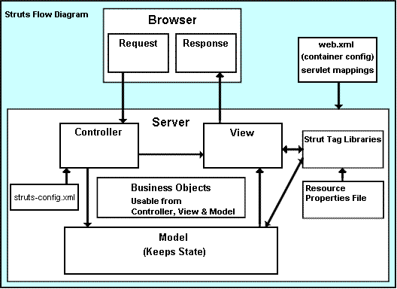
Jakarta Struts(cont…)
Digression

Slide 44
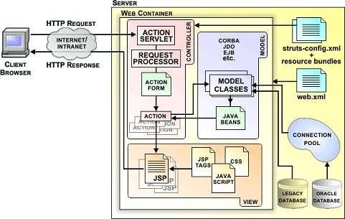
The struts architecture
Digression
<action-mappings>
<action
path="/login"
type=“com.myproject.action.LoginAction" >
<forward name=“success" path="/jsp/MainMenu.jsp" />
<forward name=“fail" path="/jsp/LoginView.jsp" />
</action>
</action-mappings>
http://my-company.com/login.action
class LoginForm extends ActionForm
{
String username,password;
public String getUsername(){
return username;
}
public void setUsername(String username){
this.username=username;
}
public String getPassword(){
return password;
}
public void setPassword(String password){
this.password=password;
}
}

Slide 45
Java Technologies
JSE (Formerly J2SE)
JEE (Formerly J2EE)
JME ( Formerly J2ME)
Digression

Slide 46
JSE(Java Standard Edition):
  Contains general purpose libraries including JDBC, JNDI (Java Naming Directory Interface), RMI (Remove Method Invocation), AWT, and Swing.
JEE (Java Enterprise Edition):
  Standard Edition plus Servlets, EJB (Enterprise Java Beans), JavaMail, Activation, JAXB (Java API for XML Binding), JSF (Java Server Faces), JMS (Java Messaging Service), and others.
  Most of the APIs are component-oriented and are intended to provide pluggable interfaces for business components to form distributed internet applications.
JME (Java Micro Edition):
  Java SE and some additional APIs for handheld devices.
Digression

Slide 47
JEE Framework
Key focus of Web application developers:
  Components, Containers, and Connectors
  Help hide Complexity, Enhancing Portability
Containers intercede between clients and components:
  Provide services transparently to both.
Connectors:
  Define a portable service API to plug into existing enterprise vendor offerings.
Digression

Slide 48
JEE
Components
  Enterprise Java Beans (EJB)
  Java Server Pages (JSP)
  Servlets
Containers (service providers)
  Web container
  Bean Container
Connectors:
  Connection service providers
Digression

Slide 49
JEE Architecture
Digression
SQL + PL/SQL in Database
EJB
Java in App Container
EJB
EJB
JavaScript in Browser
Application server
Swing
Java in JVM
Servlet
J
Java in Web Container
Applet
Servlet
D
Java in JVM in Browser
B
HTML
JSP
JSP
C
Browser
Web server
RDBMS
Client Tier
Middle Tier
Data Tier
Notes:
Note how the data-tier is always depicted as a simple HARDDISK…

Slide 50
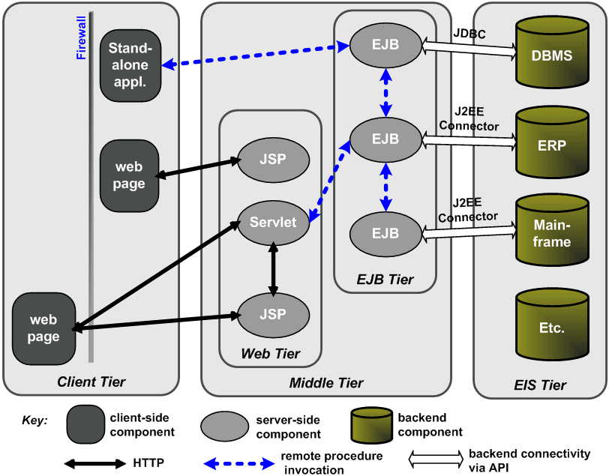
JEE Multi-tier Model
Digression

Slide 51
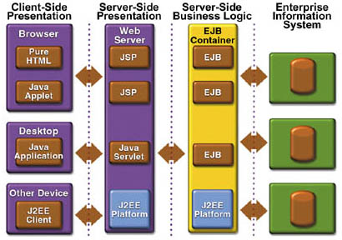
Digression

Slide 52
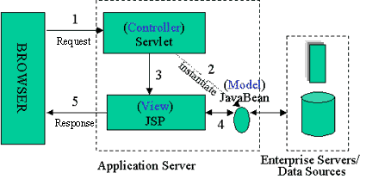
MVC Structure for JEE
Sapana Mehta (CS-6V81)
Digression

Slide 53
JEE MVC Pattern
Digression
Controller
(action servlet)
Business
logic
Http request
or post
Dispatch
Client browser
Forward
Update
Response
View
(JSP page)
Model
(server side
JavaBean/EJB)
Extract

Slide 54
Client Tier
The Client tier is the part of the application that user sees and interacts.
The Client tier is responsible for:
  Presenting data to the user, interacting with the user
  Communicating with other tiers of the application using well-defined interfaces.
Future new clients can be written using languages that may not yet even exist:
  Since they only need to conform to the interface
Digression

Slide 55
Web Tier
The Web tier is responsible for performing all Web-related processing, such as:
  serving HTML,
  formatting JSP pages for display by browsers.
  managing database connections.
Digression

Slide 56
EJB Tier
Enterprise JavaBeans are components:
  Extend servers to perform application-specific functionality.
The interface between the components and their containers:
  Defined in the EJBs specification.
Essentially, the EJBs tier provides a component model for access to distributed system services and persistent data.
Digression

Slide 57
Enterprise Information System (EIS) Tier
Digression
The EIS tier:
  Ensures that data is consistent across application boundaries.
  Access to the EIS tier is usually transactional.
  EIS tier enforces security.

Slide 58
Publish-Subscribe Pattern
Can be considered to be a generalized form of the observer pattern:
  Overcomes specific shortcomings of the observer pattern for certain situations.
An event notification system is implemented:
  An event manager class is defined to keep track of subscribers and the events they are interested in.
  Events are published by model objects by sending messages to an event manager object.
  Event manager notifies all registered subscribers via a callback.

Slide 59
Publish-Subscribe Pattern
Subscribers register their interest:
  To receive messages on a particular message topic.
Model objects:
  Publish messages on any message topic.
Neither the publisher (model) nor the subscribers know about each other.
  A rough analogy for this is an anonymous bulletin board

Slide 60
Publish-Subscribe Pattern
GUI objects
GUI object 1
GUI object m
Notify
Subscribe
Notify
Subscribe
Notify
Subscribe
Event manager for event e1
Event manager for event e2
Publish
Publish
Publish
Model objects
Model object 1
Model object n

Slide 61
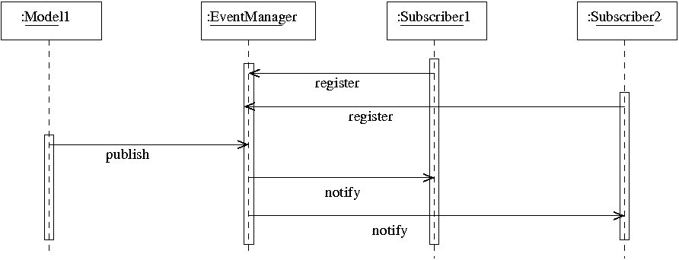
Publish-Subscribe Pattern

